Slide 1
Patient Survival Prediction
BUAN 5510 01: Capstone (Business Analytics)
Guided by: Dr. Ben Kim
Team: Sugandha Baruah, Pratiksha Chhajed, Niki Gandhi, Anusha Kumar
Notes:
Hello everyone, we are a team of four with myself (Sugandha), Pratiksha, Niki and Anusha. We are going to present our research for how better we can predict the survival rate of the patients.

Slide 2
Agenda
Dataset Description
Data Modelling
Methodological Contribution
Limitations
3
5
7
9
Problem Statement
10
1
Future Scope
2
4
6
8
Background Information
Data Preprocessing
Stakeholder Management
Conclusion & Recommendation
Notes:
Our agenda for today which we are going to communicate our research findings to different stakeholders.

Slide 3

Develop and validate a predictive model for all-cause in-hospital mortality among admitted patients and detect and visualize significant indicators of survival rate among patients.
Notes:
So, let’s start!
Our problem statement here is we aim to develop and validate a predictive model by detecting and visualizing significant indicators of survival rate among patients. And to understand what features are important for patient mortality prediction.
------------------------------------------------------------------------------------------------------------------------------------------------------------------------------------------------------------------------------------------------------------------------
We want our research results to be used in real life for survival of the patients.

Slide 4



Background Information
High Growth Industry
Technology Advancements
Big Data Analytics
Notes:
So, why we chose this problem statement?
As we all know, healthcare plays a crucial role in human life, and the predictors of in-hospital mortality for admitted patients remain poorly characterized. Data Analytics plays an important role in the healthcare sector as it provides valuable insights from available data to enable doctors and health administrators to make more informed decisions.
---------------------------------------------------------------------------------------------------------------------------------------------------------------------------------------------------------------------------------------------------------------------
Knowledge about chronic conditions can inform clinical decisions about patient care and ultimately improve patient survival outcomes.
Implementation of the latest technologies like medical imaging, Artificial Intelligence, and Internet of Things (IoT) devices generates huge amount of data. And with these growing new approaches, Data Analytics plays an important role in the healthcare sector. This also creates a question for Data Analysts working in healthcare domain to derive valuable insights from available data to enable doctors and health administrators to make more informed decisions.
Hence, we are brining a solution through our research by developing models to predict in-hospital mortality rate.

Slide 5

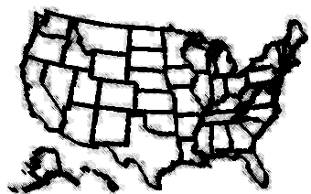


https://www.kaggle.com/datasets/mitishaagarwal/patient
31.41 MB
Across United States
Data Description
Data Source
Across United States of America
Location
31.41 MB
3 tables
Number Of Tables
31.41 MB
File Size
Notes:
To quickly brief on the dataset,
First, we sourced them from Kaggle for the patients across the united states. Originally, we had three datasets Diagnosis, Patient demography, and Intensive Care unit. with a
We then merged them together using primary and foreign key to create final dataset.
-----------------------------------------------------------------------------------------------------------------------------------------------------------------------
Before we jump into the effectiveness of our models for non-technical stakeholders, let’s discuss the technical aspect of our research to be understood by analytics and data science professional from healthcare industry.

Slide 6

Literature Review
Early Detection of In-Patient Deterioration: One Prediction Model Does Not Fit All
Improving the Prediction of Heart Failure Patients’ Survival Using SMOTE and Effective Data Mining Techniques
Machine learning-based early warning system enables accurate mortality risk prediction for COVID-19
Early detection of type 2 diabetes mellitus using machine learning-based prediction models
I
F
Notes:
We read several research papers on how machine learning models have focused on addressing clinical deterioration in patients and efficiently predicted the survival of patients with different ailments that aided to our research work.

Slide 7
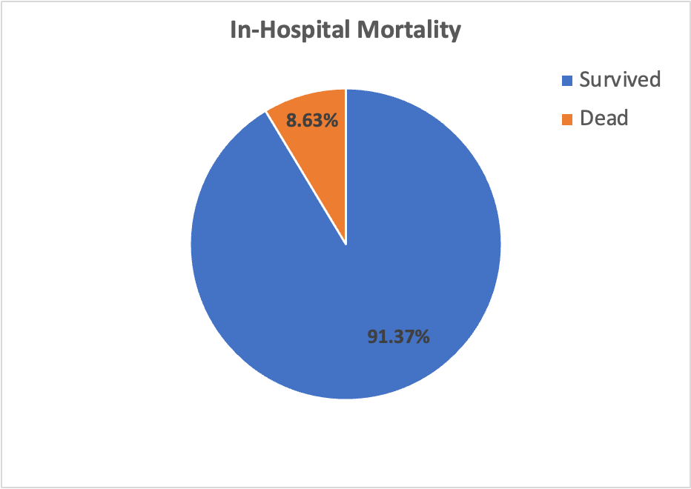
Data Exploration
Death rate (8.63%)
Survival rate (91.37%)
Notes:
With that we started with our first exploration, on the mortality rate of patients. We observed that
91.37% accounted for survival
whereas only around 9% of the samples accounted for death .
We see that out data was highly imbalanced with respect to deaths and realized the need to balance the data in order to be able to predict the patient's mortality status more accurately.

Slide 8
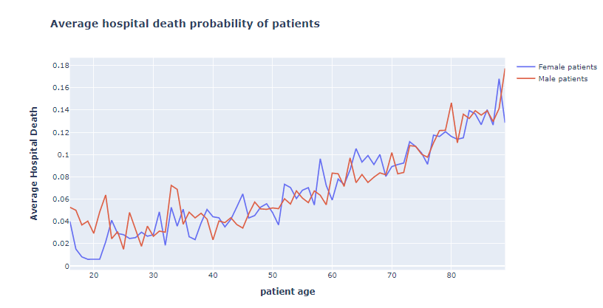
Data Exploration
At the age of 80, male patients have high average death rate
At the age of 60, female patients have a high average death rate
Notes:
Further we observed that the age range of admitted patients who were more prone to hospital admission were in the group of 60-80.
Also, male patients have a higher average death rate than female patients.
----------------------------------------------------------------------------------------------------------------------------------------------------------------------------------------------------------------------------------------------------------
We can also see that throughout the general trend depicts that male patients have a higher average death rate than female patients. An exception is between the age groups of 50-55 years, where females have a higher average death rate.
An exception is between the age groups of 50-55 years, where females have a higher average death rate.

Slide 9
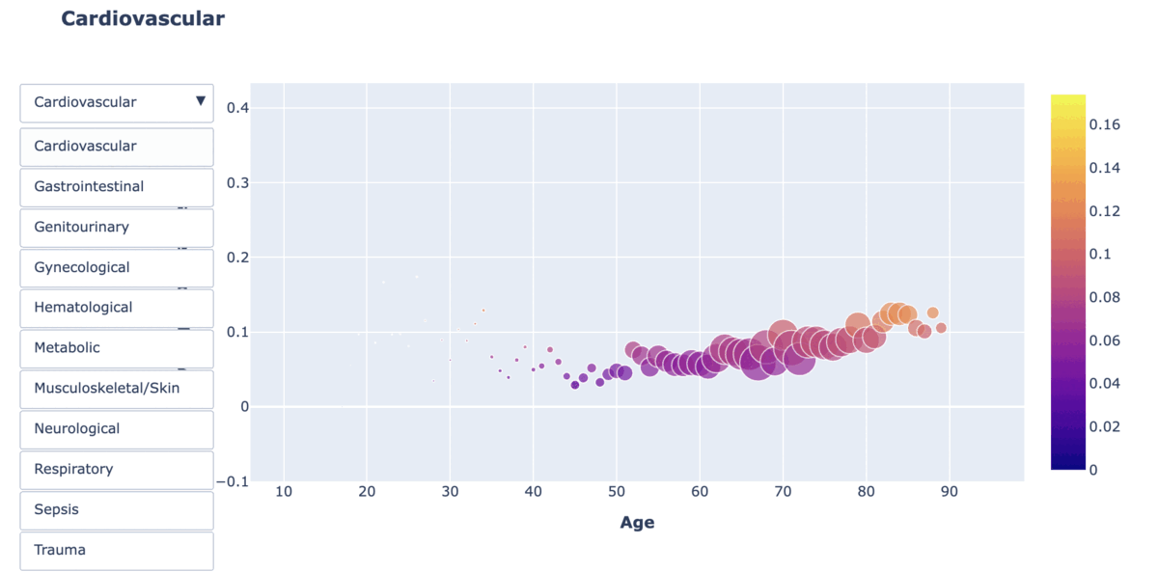
Data Exploration
The scatter plot describes the average death probability among different age groups admitted patients by ailment type
For Example:
Patients above 60 years (senior citizens) suffer more from Cardiovascular problems compared to other health issues and average death probability for them increases with age.
Notes:
Lastly, In this exploration, we described the average death probability between the patient's age and avg hospital deaths by each ailment.
For instance, patients above 60 years suffered more from Cardiovascular problems compared to other health issues .
---------------------------------------------------------------------------------------------------------------------------------------------------------------------------------------------------------------------------------------------------------------
My Understanding Note: Not to present
X-axis - Age
Y-axis - Avg Hospital deaths
Sphere size - No. Of admitted patients in that age range category with specific disease/ailment
Color chart – describes the probability of death above the average rate for the specific age group and disease. The Color code changes with the intensity or the severity of the ailment

Slide 10
Data Preprocessing
Frequency Distribution
Null Values Treatment
Outlier Treatment
Correlation Analysis
One Hot Encoding
Normality Distribution
Null Values Imputation
Box Plot
Heat Map
Multicollinearity
Categorical Variables
Notes:
The next step we did was to preprocess the datasets by plotting histogram to check if its normally distributed. Imputed missing values with KNN and checked through box plot to see outliers. Post that, we did correlational analysis to avoid multicollinearity issue and transformed all categorical variables into numeric.
---------------------------------------------------------------------------------------------------------------------------------------------------------------------------------------------------------------------------------------------
The next step in the process was data preprocessing where we first removed irrelevant columns like patient id, hospital id etc. that did not contribute to data analysis and then we plotted histograms to observe if the attributes were normally distributed or not. Then we treated the null values by imputing the values with KNN for the attributes below 5% threshold. Next, we created box plot to check outlier, however, we had to drop the process as 50% of the values were lost. We also did correlation analysis and dropped 8 features which were above the threshold of 80% to avoid multicollinearity issue. Lastly, we did one hot encoding to convert all categorical variables in numeric.

Slide 11
Data Preprocessing
Dimensionality Reduction
Data Balancing Techniques
Principal Component Analysis (PCA)
Feature Selection
Naïve Random Over Sampling
Synthetic Minority Over-Sampling Technique (SMOTE)
Notes:
As discussed earlier, our dataset was highly imbalanced and could result in biases predictions from the models . Hence, we went ahead with two different balancing techniques: Naïve Random Over-Sampling and SMOTE (Synthetic Minority Over-sampling Technique).
And we found that SMOTE is more effective when compared results. Hence, we considered SMOTE for our further modeling approach.

Slide 12
Data Modelling
DECIDING MODELLING TECHNIQUE
CLASSIFICATION MODELLING
HYPER-PARAMETER TUNING
RANDOMIZED SEARCH CV
GRID SEARCH CV
MODELLING
K-NEAREST NEIGHBOURS
DECISION TREES
RANDOM FOREST CLASSIFIER
GRADIENT BOOSTING CLASSIFIER
XG Boost
NEURAL NETWORK
PERFORMANCE METRICS
COMPARISION
ACCURACY, RECALL, PRECISION, RUNTIME
VALIDATION
K-FOLD CROSS VALIDATION
DECIDING BEST MODEL
?
Notes:
Quick recap – Classification of in-hospital patients mortality
The next step was to hyper tune the parameters to overcome underfitting or overfitting of the algorithm on dataset.
Post that we applied 6 algorithms namely KNN, Decision Tree, RF, NN, Gradient boosting and XG boost
And checked for the performance metrics and runtime for each of the combination of dataset type and classification model.
Finally, we used K-fold cross validation technique to validate our results through mean accuracy value for each model.

Slide 13
Model Accuracy and Run time
 | Original Unbalanced |  | Original Balanced |  | Reduced Unbalanced |  | Reduced Balanced
 | Accuracy | Runtime | Accuracy | Runtime | Accuracy | Runtime | Accuracy | Runtime
Random Forest Classifier (RFC) | 93% | 25.07s | 94% | 90.64s | 93% | 28.10s | 91% | 122.31s
Gradient Boosting Classifier (GBC) | 93% | 476.58s | 97% | 1292.28s | 93% | 328.63s | 97% | 1106.99s
XG Boost (XGB) | 93% | 178.28s | 94% | 256.45s | 93% | 43.53s | 93% | 123.02s
Neural Network (NN) | 90% | 98.89s | 37% | 220.45s | 91% | 69.34s | 59% | 128.71s
Notes:
One of our interesting observations wrt Accuracy and Runtime was that
we observed a reduced balanced dataset, gradient boosting took 1100 secs to run while XG Boost gave similar accuracy within just 123 secs which is around 9 times less.
, ---------------------------------------------------------------------------------------------------------------------------------------------------------------------------------------------------------------------------------------
For example, if we observe a reduced balanced dataset, gradient boosting took 1100 secs to run while XG Boost gave similar accuracy within just 123 secs which is around 9 times less.
In contrast, KNN and Neural Network algorithms gave low accuracy of 9% and 37% compared to other models for original balanced dataset.
and XG boost models gave better performances with an accuracy of around 93%.

Slide 14
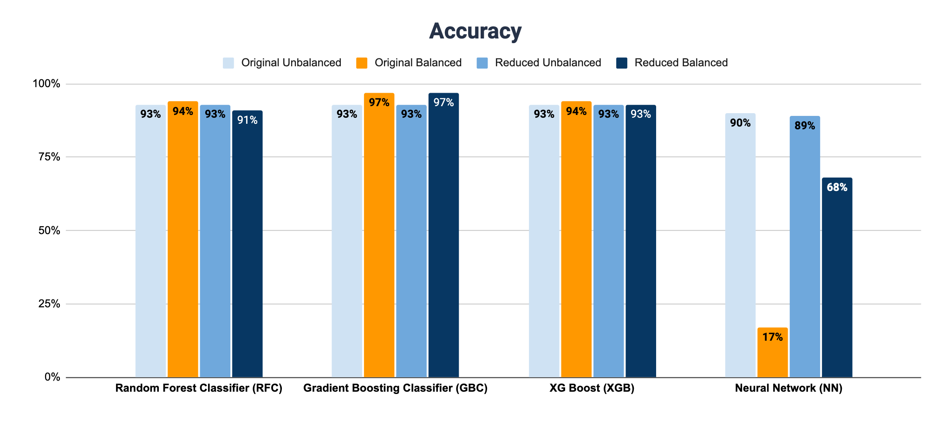
Accuracy
Notes:
Tried to observe a pattern among various models. We observed that, in general, accuracy is better for balanced datasets for all models. An exception as seen in the chart is neural network.
Gradient Boosting Classifier gave the best overall accuracy for all Datasets.

Slide 15
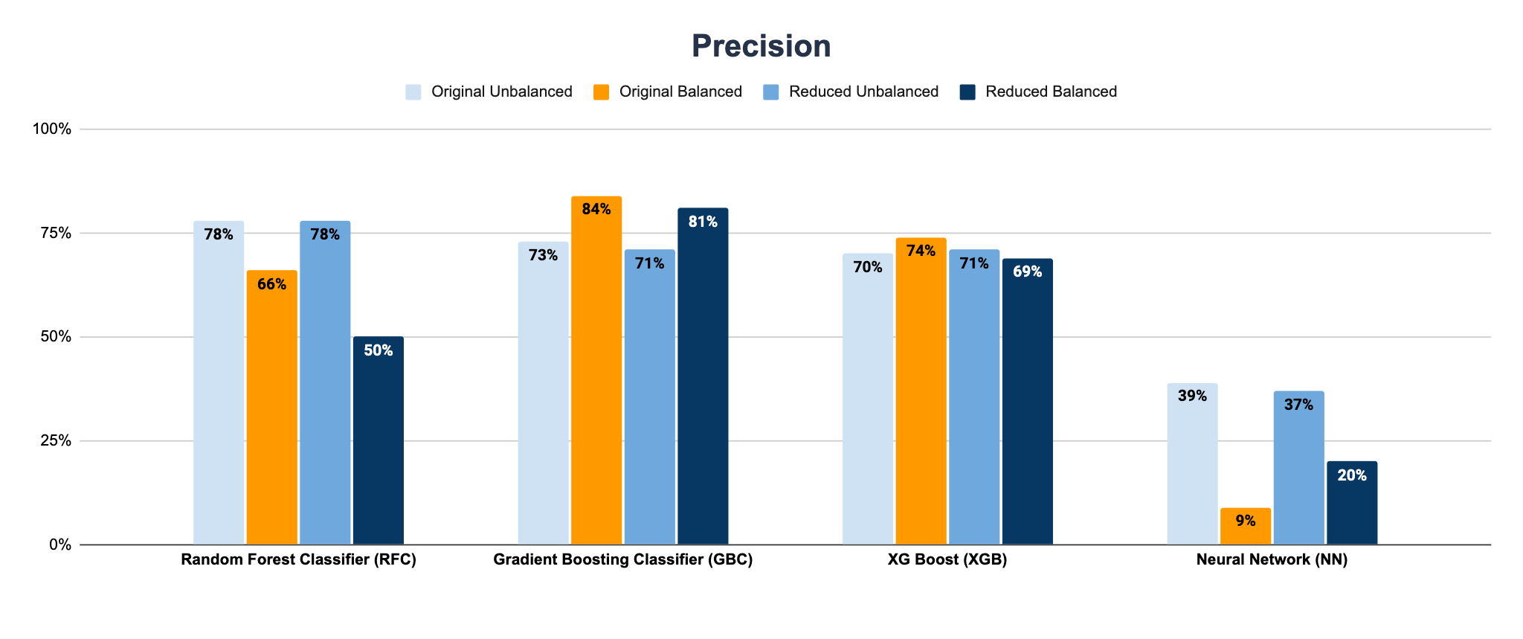
Precision
Notes:
accuracy is not the ultimate performance metric. qualitative measure. Considering the Precision performance metric for all the models, we can see that the Gradient Boosting model performs the best consistently with 84% for the original balanced dataset, 81% precision for the Reduced balanced dataset.

Slide 16
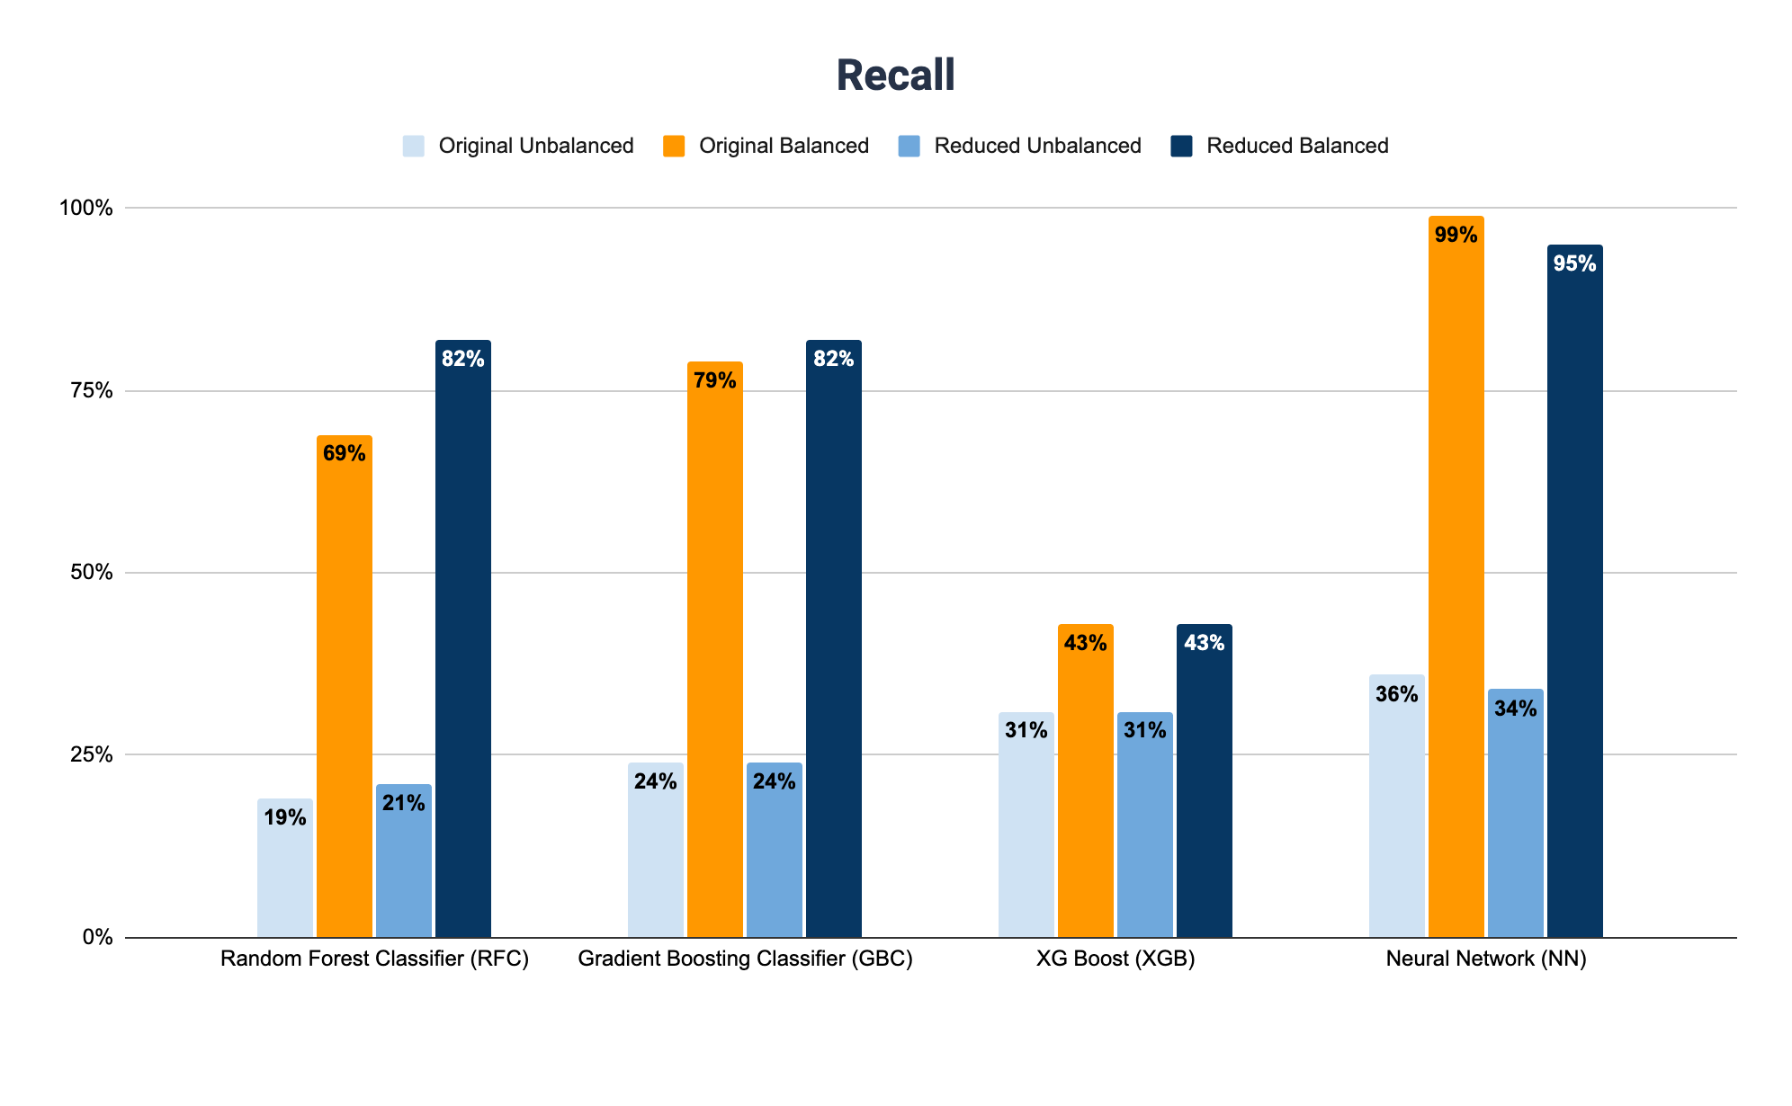
Recall
Notes:
In mortality prediction, recall of the model plays a vital role. Recall is quantitative performance measure. From the chart, We observed that Neural Network with Reduced Balanced dataset provided the highest recall.
Now that we have a basic understanding of summary of the our research, I would like to call Pratiksha to eloborate on how our findings can be helpful for Non- Technical audiences

Slide 17






Methodological Contribution
Traditional Methodologies
Basic software programs such as MS Excel, SPSS, STATA, and other traditional models
v/s
Machine Learning Models
Application of robust supervised classification ML models
Limited Dataset
Sparse dataset of patient cohorts with the same ailment
v/s
Diverse Data Source
Multiple attributes from diverse data source could enable better predictions.
Offline System
Expensive offline systems for data storage
v/s
Cloud Desktop
Cost effective and time efficient cloud infrastructure
Notes:
Thanks Anusha, since we have seen the technical results retrieved from our research, I would like to highlight the contributions we have made through our research results.
Earlier researches in the domain used more traditional methodologies to predict the survival rate among patients which could not provide better prediction. Unlike these researches, we have implemented robust Machine Learning models to address challenges like data quality, model decay, feature stability, prediction performance.
Also, earlier researches were done on limited datasets with patient cohorts suffering from the same diseases but in our study, we have a wider spectrum of variables that consist of different ailments and predict the overall survival rate of patients irrespective of their illness.
Lastly, our important contribution comes with advancement of technology usage. Unlike previous researches, we have leveraged the widely available cost-efficient cloud infrastructure for our modelling by using Google Collab. This is a Open jupyter notebook by google which has reduced time and cost for us in terms of hardware and software infrasturcture.
Model robustness refers to the degree that a model’s performance changes when using new data versus training data. Achieving model robustness requires understanding and managing a number of technical challenges. Managing model robustness requires understanding specific challenges related to:
data quality
model decay
feature stability
precision vs. recall
input perturbations

Slide 18



Non-Technical Stakeholder Management
Health Care Clinician
and Professionals
Hospital Management
Researchers in Healthcare
Pharmaceutical
Companies
Health Insurance
Companies
Notes:
This brings us to most important part: Stakeholder Management.
During our efforts to develop a model on technical grounds, we also kept our non-technical stakeholders in mind.
Let’s see how our research will help Healthcare Professional, Hospital Management, …… to address their painpoint.
--------------------------------------------------------------------------------------------------------------------------
We used a framework to identify the pain points of our stakeholders and address them through our research.
Machine learning Solution developed by us for better and accurate prediction of in-hospital mortality will be useful for stakeholders like Healthcare professional like doctors and clinicians, Researchers in the field, pharmaceutical companies, and health insurance corporations.
Let’s elaborate on how our research can prove to be an aid for these stakeholders

Slide 19
Non-Technical Stakeholders Management
Health Care Clinicians and Professionals
Hospital Management
Analysis of Huge Volume of Patient Data
Informed Decisions
End-of-life Care
Better Infrastructure Management
Easy Model Integration
Notes:
The predictive analytics model presented by us will play a crucial role in advancing care and enhancing results in the healthcare industry by
1. helping physicians to analyze the vast amount of patient health and demographic data effectively.
2. Health care professionals frequently experience prognostic uncertainty and may find it challenging to provide families with an information of the expected outcomes of diseases. With the aid of our prediction models, these difficulties will now be easier to overcome.
3. Thirdly, as the accurate survival prediction is highly valued in the clinical practice of end-of-life care. Our prediction models enable better communication and preparation for impending death, helping old age people avoid futile medical treatment.
Next stakeholders who will benefit is hospital management.
1. as, research results will be a great resort for hospital management at all levels for better investment decisions in the health technology sector like ICU beds and patient infrastructure.
2. Hospital management can easily integrate this model into the system for better in-hospital patient care and resource management.
----------------------------------------------------------------------------------------------------------------------------------------------------------------------------------------------------------------------------------------------------
conduct multiple and preparation for impending death, and helping old age people avoid futile medical treatment, and facilitating optimal palliative care quality for patients, families, and physicians altogether.
Successful applications of machine learning in healthcare often necessitate significant integration efforts. Integrating our model's output into intricate human workflows can translate modeling advancements into improvements in clinical treatment. Further, clinicians frequently experience prognostic uncertainty and may find it challenging to provide families with an informed assessment of the expected outcomes of treatment decisions. Clinicians, patients, and families might all be vulnerable to unconscious but significant cognitive biases when making judgments under pressure, further adding to the complexity of these situations. With the aid of our prediction models, these difficulties will now be easier to overcome and support medical decision-making for healthcare professionals.
Additionally, accurate survival prediction is highly valued in the clinical practice of end-of-life care. Our prediction models enable better communication and preparation for impending death, helping old age people avoid futile medical treatment, and facilitating optimal palliative care quality for patients, families, and physicians altogether.
Our exploratory data analysis leverages the feature importance technique to select the prime attributes influencing patient mortality. This will enable hospitals in gathering crucial medical and demographic details from patients to make more informed decisions about treatment based on mortality prediction using the above-collected data.
Further, these key features from our analysis will help researchers in the pharmaceutical industry to utilize this data for important drug developments for diseases having a significant impact on patient death. Ultimately, this will help improve in-hospital survival among patients suffering from those illnesses.
Our model will also come as an aid for hospital management who can integrate this model into the system for better in-hospital patient care and resource management for themselves and their patients.
Our predictive models will prove to be a great resort for hospital management at all levels to use available data as an asset to make investment decisions in the health technology sector for ICU beds and patient infrastructure. Lastly, the above patient survival prediction models can also be utilized by Health Insurance corporations in evaluating prospective customers’ survival or mortality rate during the decision-making process for insurance plan offers and respective premium charges.

Slide 20
Non-Technical Stakeholders Management
Researchers in Healthcare
Pharmaceutical Companies
Health Insurance Companies
Data Driven Research
Gather Crucial Data
Drug Development
Insurance Premium Forecast
Offer Diverse Health Plans
Notes:
Further our research will be helpful for Researchers in healthcare industry
1. As they can rely on our prediction models help identify patients who are at risk of death and then recommend treatment plans to the medical staffs.
2. Also, our exploratory data analysis leverages the feature importance technique to select the prime attributes influencing patient mortality. This will enable researchers to decide and prioritize what crucial medical and demographic details need to be collected from patients.
Further, our exploratory data analysis and models will also help the pharmaceutical industries to utilize this data for important drug developments for diseases having a significant impact on patient death. Ultimately, this will help improve in-hospital survival among patients suffering from those illnesses.
Lastly, the above patient survival prediction models can also be utilized by Health Insurance corporations in evaluating prospective customers’ survival or mortality rate during the decision-making process for insurance plan offers and respective premium charges.
With technical analysis and non-tech stakeholder management, we are ready to provide final recommendations. For which I will hand over to Niki.

Slide 21


Conclusion & Recommendations
Model Recommendations
Cloud Infrastructure
Best Accuracy and Precision:
Gradient Boosting Classifier
Cost Efficient and Faster Processing
Best Recall: Neural Network
Massive Data Storage Capability
Notes:
After analyzing the results, we recommend adopting the model that is most aligned with the hospital's needs. If the end goal is to improve accuracy and precision, then the Gradient Boosting model should be preferred. Whereas, if one is interested in achieving the highest recall, then Neural Network is the most recommended one.
Lastly, we recommend using a cloud desktop for cost-efficient results. It is a smart move to utilize the cloud computing infrastructure for faster processing when implementing predictive models. Also, with an increase in clinical data, it is expensive and tedious to maintain data on local offline systems hence we suggest the use of Cloud desktops.

Slide 22




Limitations
Dataset Limitation
Extreme/ Odd Cases
The model may not work the best for patients with
Fails to include crucial socio-demographic information
Infant Mortality Prediction
Model does not support infant mortality prediction
Clustering
The nature of data does not support clustering
severe health conditions
Missing Attribute Values
Notes:
Limitations are inevitable part of any research. Let's discuss few of the limitations in our study.
One of our major constraints was that the dataset failed to include crucial information relating to the socio-demographics of in-hospital patients. Information such as State/Region of residence, lifestyle, education, job type, salaries, and working conditions will turn out to be a value addition. These factors could have helped develop a commonality between patients affected by a similar illness/disease and suggest a cure to prevent the occurrence of these illnesses.
Also, the dataset had missing values that had to be imputed. It would be better if all data is available.
2) Secondly, the model might not work best when certain extreme/odd cases are considered. Without careful instruction on how to interpret model output, clinicians may underestimate in-hospital mortality risk for patients with severe conditions that would usually receive intensive treatment.
3) Also, If our dataset supported clustering then we would have been able to capture some descriptive insights which could have helped in mortality prediction
4) Lastly, our model may not be suitable for infant mortality prediction due to the limited data availability, as our dataset only consisted of patients between the age group of 16 to 90 years of age.

Slide 23




Future Scope
Early symptom detection will be beneficial in increasing the chances of a patient survival
Collaborate with other companies to transform our model into an application
Health Conditions Based Predictions
Enormous Mortality Data
Partnering with Other Companies
Real-Time Data
Enhance the model results in the future by including more patient data with in-hospital deaths
Mortality prediction with built-in advanced technology functionalities in real-time environment
Notes:
We further plan on improving our work by diving deeper to analyze and predict the percentage survival rate for in-hospital patients based on the severity of the patient’s condition during the time of admission. Early symptom detection could prove to be beneficial in increasing the chances of a patient's survival
Our data currently constituted less than 10% of patients who died after being admitted to the hospital. Thus we had to synthetically impute the samples for precise and accurate mortality prediction. The model's performance can be improved, if we get access to a huge amount of in-hospital patient mortality data
In the future, we can collaborate with other businesses/companies in order to fit our model into an application so that it can be easily accessible and more user-friendly.
Additionally, with the advanced technology infrastructure, the in-patient mortality prediction model can have functionalities to run in a real-time environment.

Slide 24
THANKS!
Any questions?
Notes:
There is a large scope for future work. We want to do more research and are open to collaboration if anyone wants to invest with us. Thank you so much!

